Slide 1

AC Currency Converter Website Demonstration
Present By- Zhengyuan Liu (William)
Partha Sinha
Ernesto Davila

Slide 2
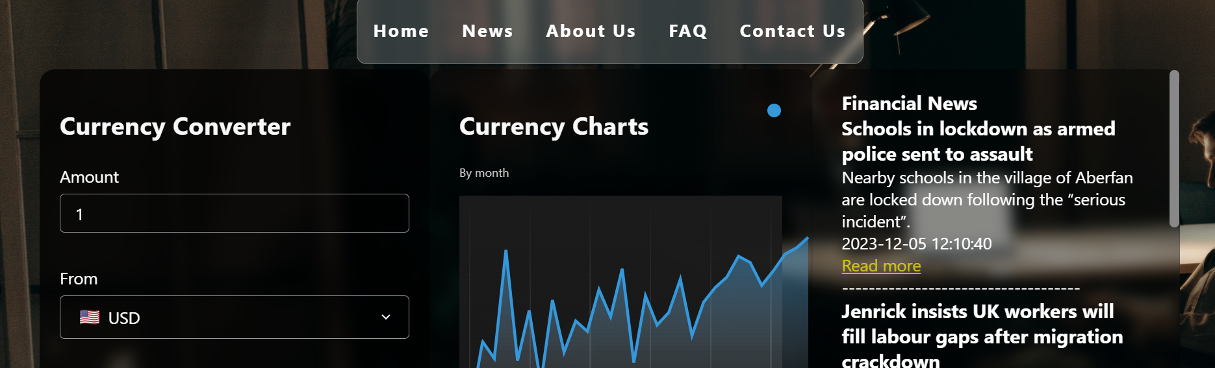
Algonquin College (AC) Currency Converter
The AC Currency Converter- overview
Importance of currency conversion
Key features of the website

Slide 3

Navigation
Different Sections of our website
Home
News
About Us
FAQ
Contact Us

Slide 4
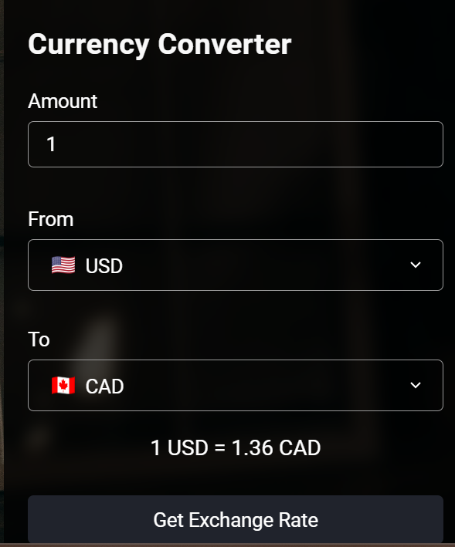
Currency Converter
Display the main currency conversion form
Highlight key elements such as-
Amount
From
To
Get Exchange Rate button

Slide 5
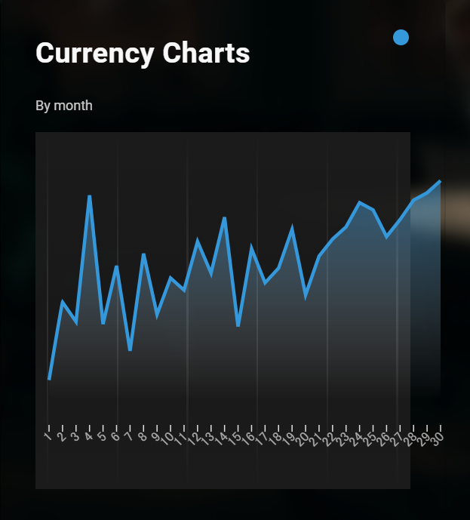
Currency Charts
Introduce the currency charts section
Mention the significance of currency charts
Show the historical currency conversion rate for that 2 currencies.

Slide 6
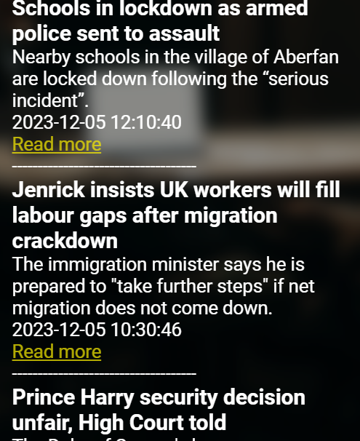
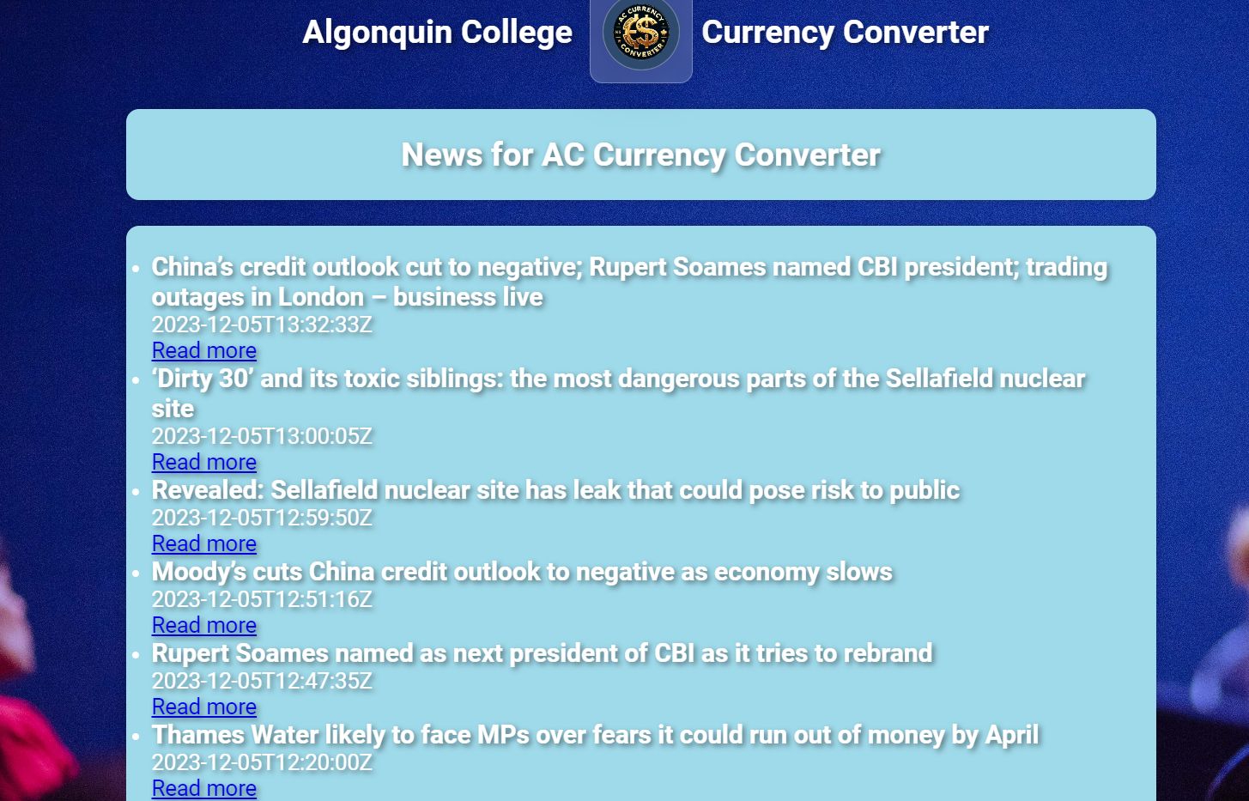
Financial News
Emphasize the importance of staying informed- why we need to know what is happing in the world financial market.
Information will impact currency conversion rates.
Showcase the news feed

Slide 7

About Us
We three Partha Sinha, Ernesto Davila, Zhengyuan Liu tried our best to set up this website
We divided our task and help others to set up this website.
We also critically evaluated teammates for his work.

Slide 8
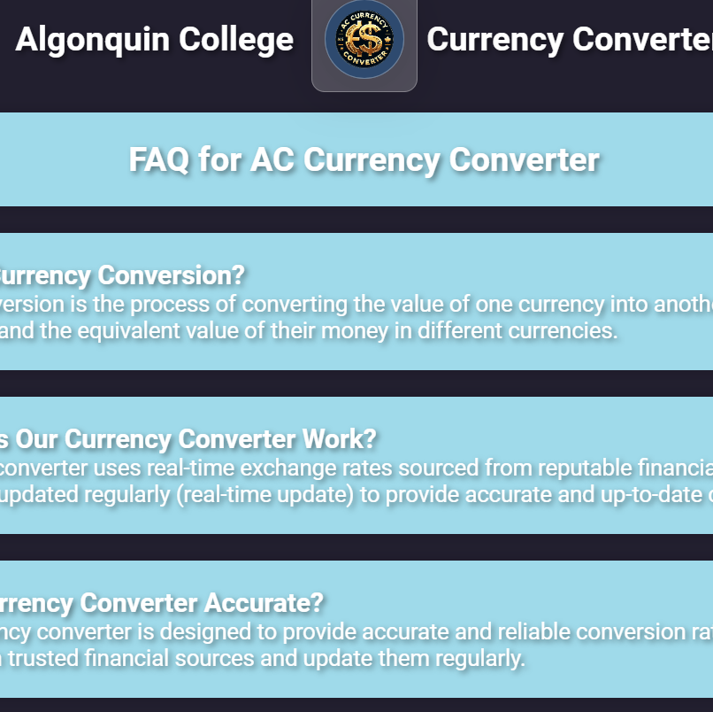
FAQ Section
We added some frequently asked questions in our website regarding currency conversion.
Cover topics like accuracy, supported currencies, fees, security, and embedding, etc.

Slide 9
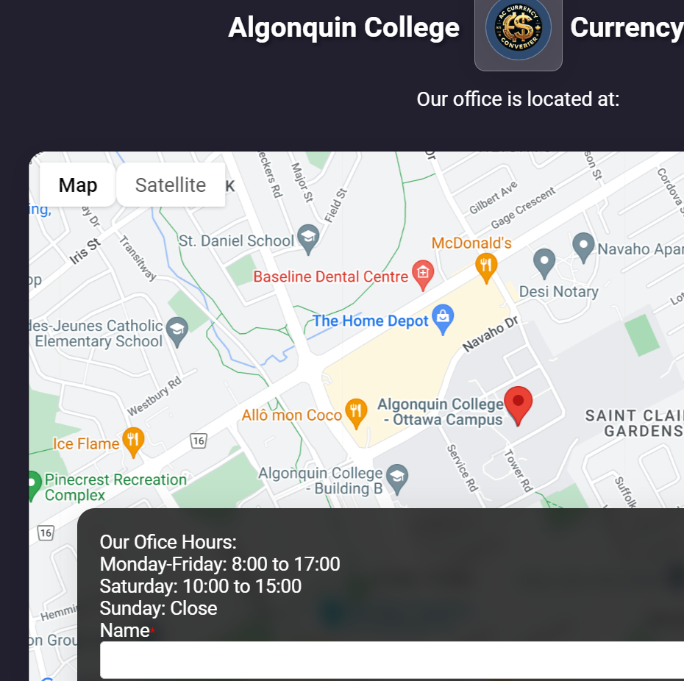
Contact Us
It provide our office location on a map.
Display office hours
Include the contact form for user inquiries.

Slide 10

Footer
Display the footer information with contact details
Show links to relevant videos regarding financial information

Slide 11
Thank You!
Any Questions?

